Slide 1
Embedded and Real-Time Systems (EENG 34030): Main Problem Submission Group 04
QINGYU ZHANG and vn22984
SHURAN YANG and rw22242
HAIBO LIAN and tb22111

Slide 2
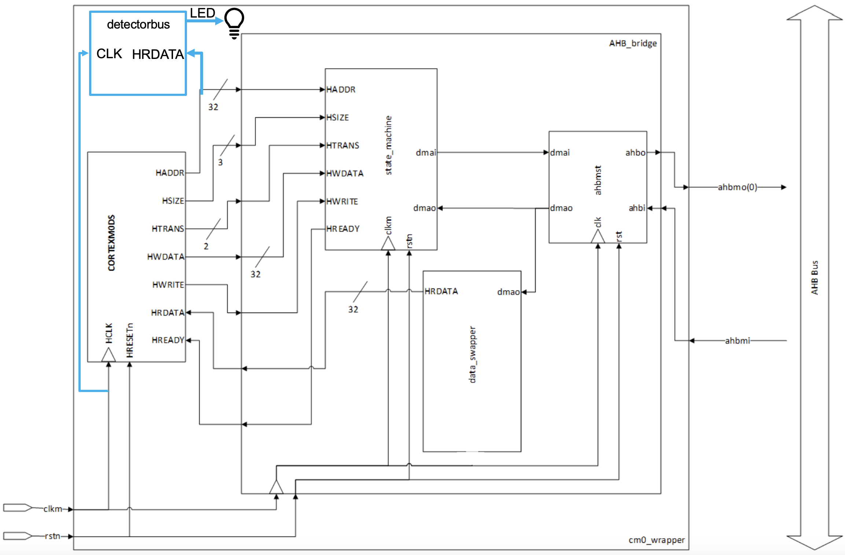
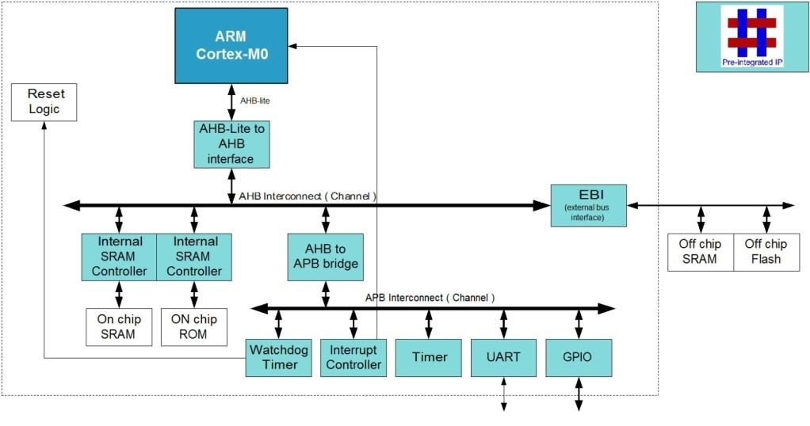
Goal & Overall Layout
The responsibility of our group is to design a bridge and integrate the Cortex M0 with the SoC.
Figure 1.1 The goal and the connection of the detection module.

Slide 3
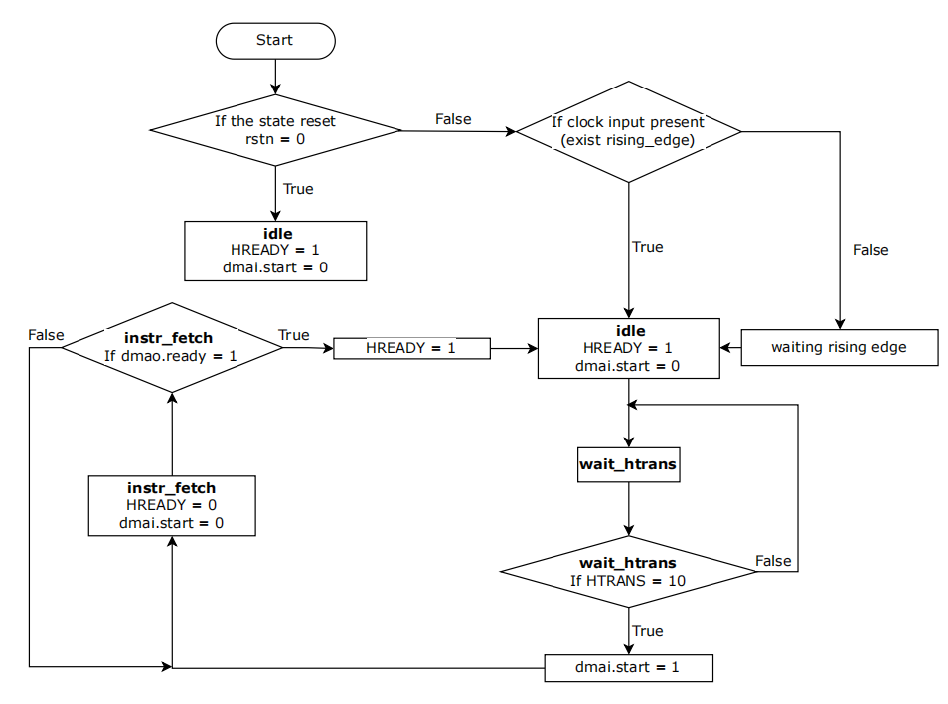
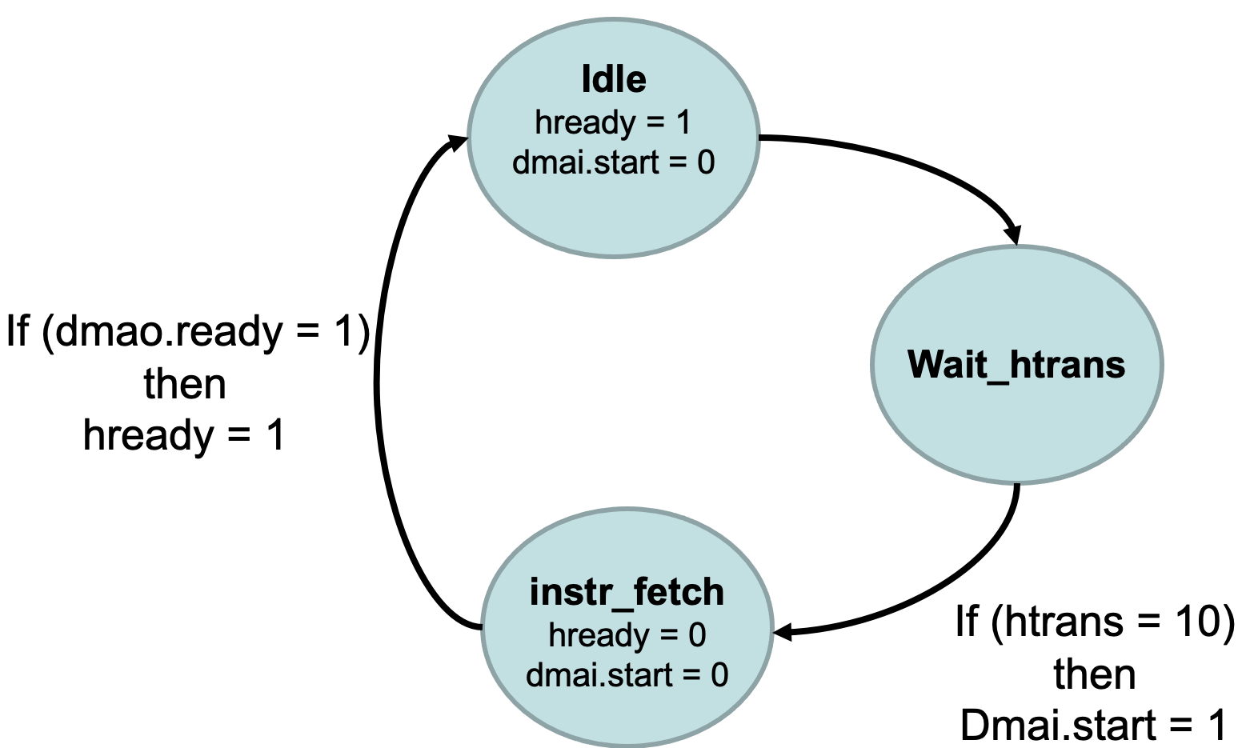
State machine flowchart :
Figure 1.2 The State machine diagram.
Figure 1.3 The State machine flowchart.

Slide 4
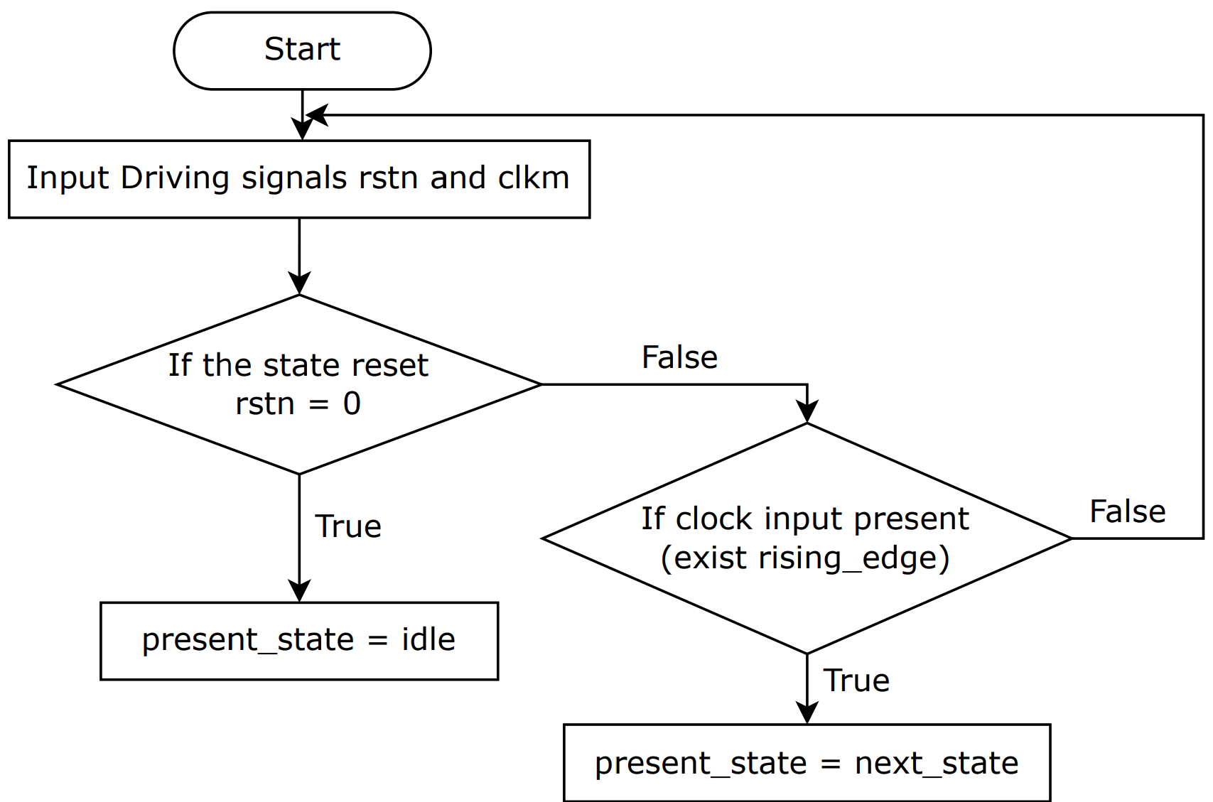
State machine flowchart :
In the design of the state machine we use three processes, namely reg_sate, com_state and output_state. The flow charts of three processes and a general flow chart are drawn respectively.
Figure 1.4 The reg_sate machine flowchart.

Slide 5
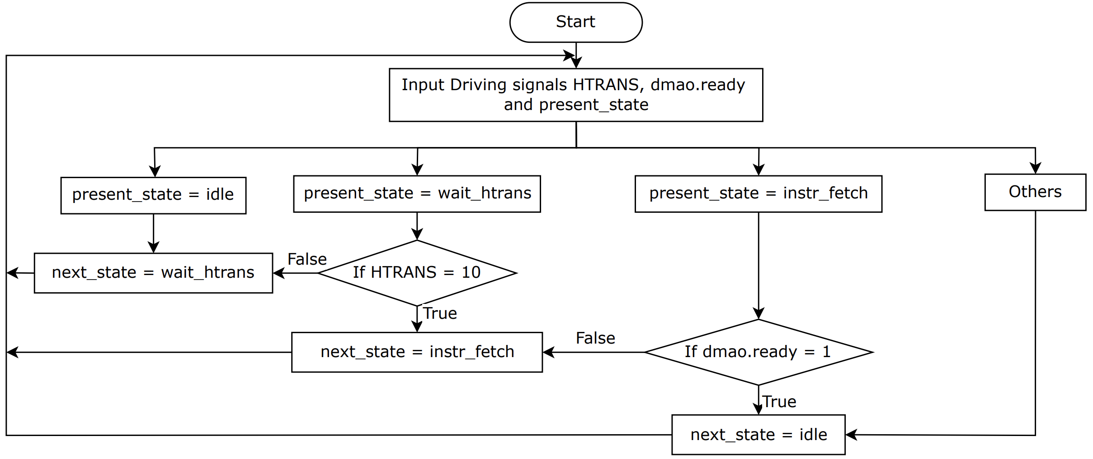
State machine flowchart :
Figure 1.5 The com_sate machine flowchart.

Slide 6
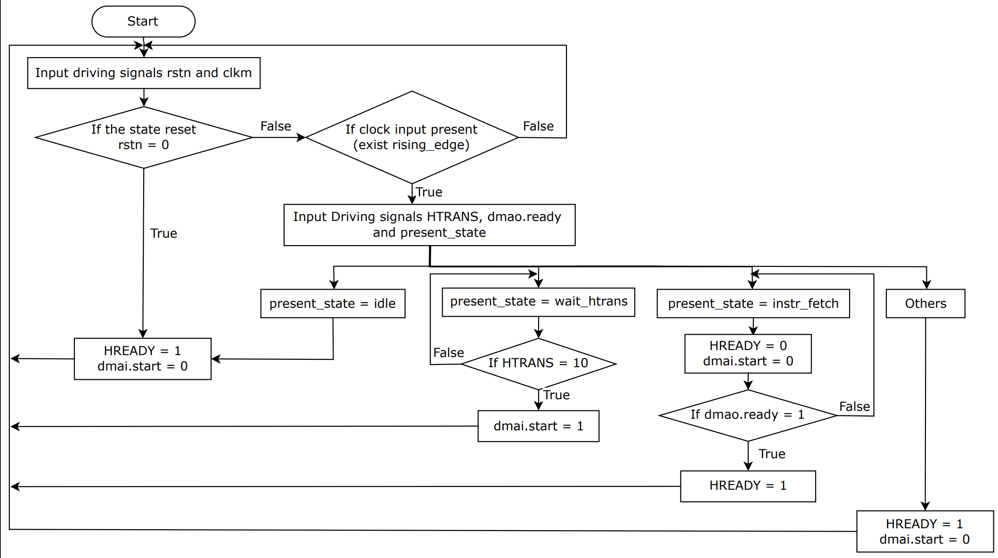
State machine flowchart :
Figure 1.6 The output_sate machine flowchart.

Slide 7
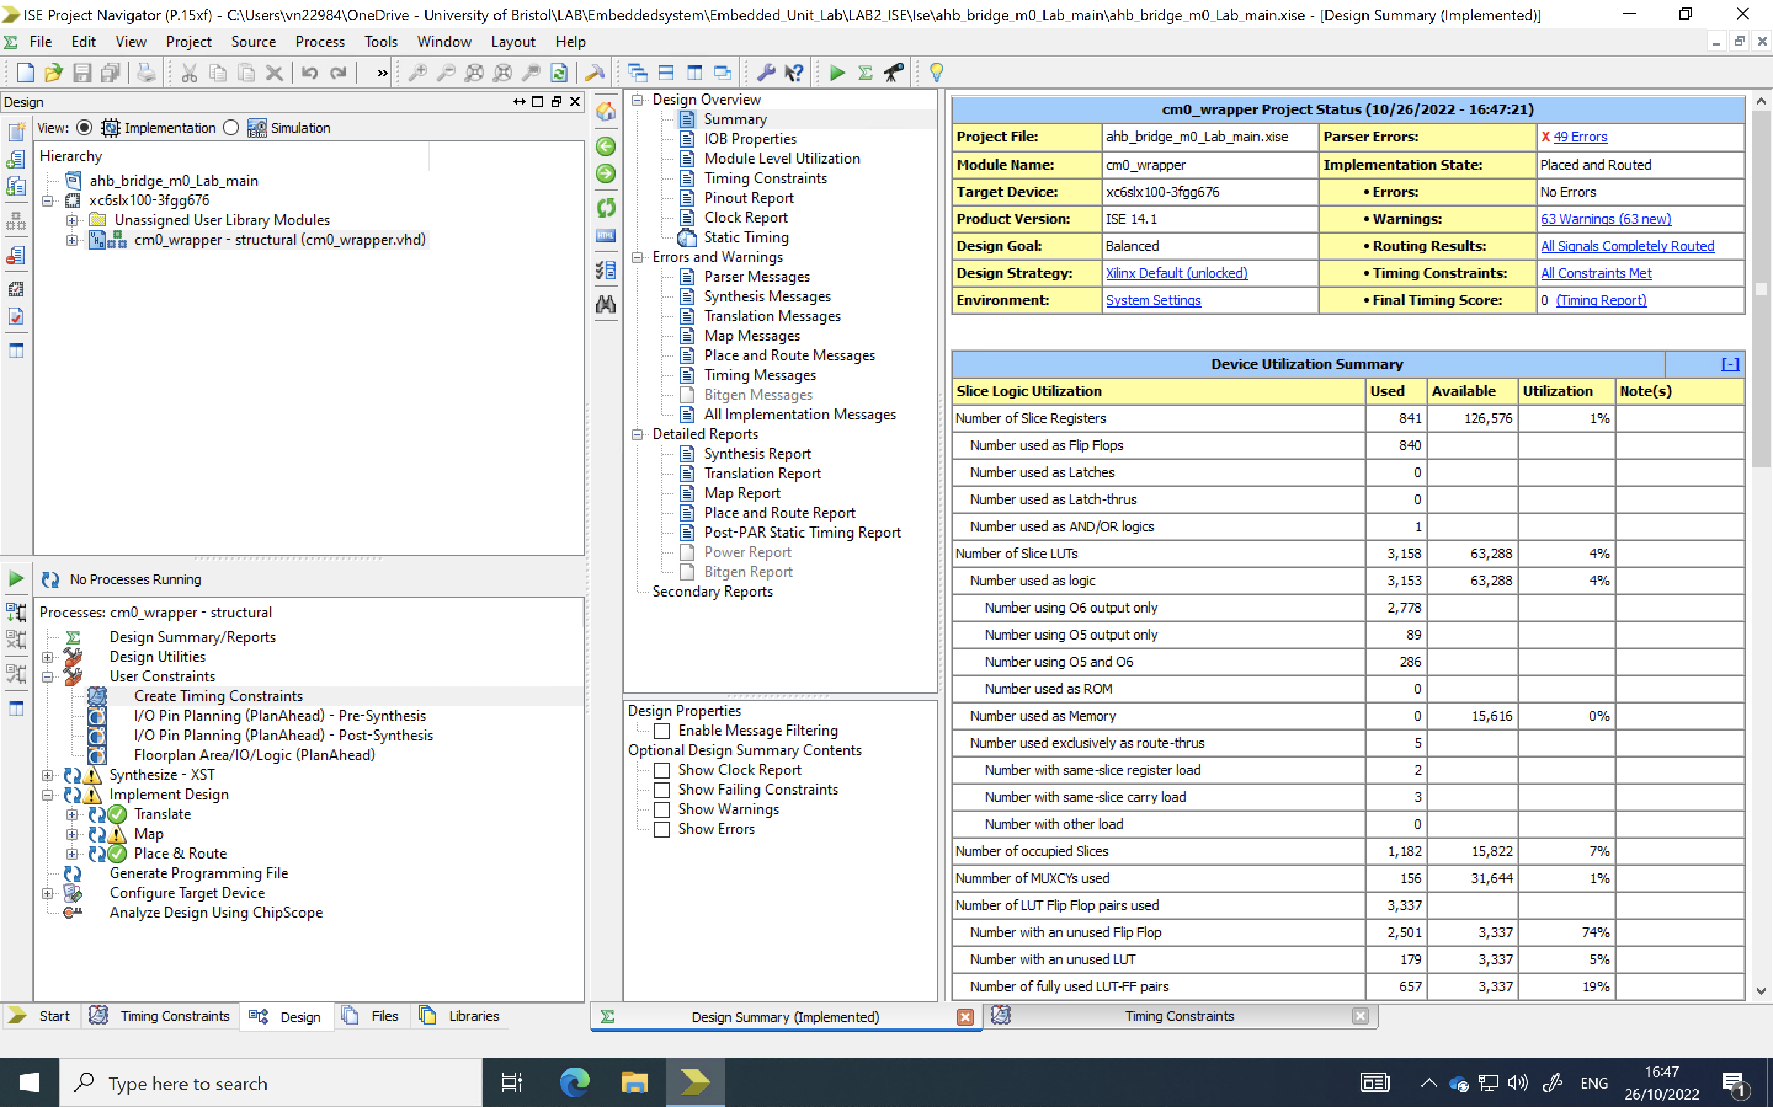
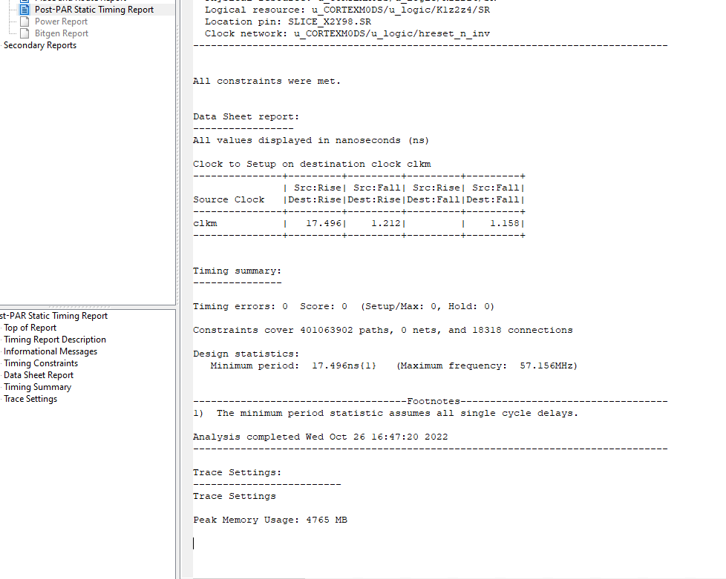
FPGA Implementation Details Table:
FPGA device selected: | Spartan 6 xc6slx100-3fgg676
Total Number of occupied Slices: | 1182
Total Number of Slice Flip Flops: | 840
Total Number of Slice LUTs: | 3518
Best possible clock frequency: | 57.156MHz
Cortex-M0 Number of occupied Slices: | 1176
Cortex-M0 Number of Slice Flip Flops: | 830
Cortex-M0 Number of Slice LUTs: | 3136
Bridge Number of occupied Slices: | 3
Bridge Number of Slice Flip Flops: | 7
Bridge Number of Slice LUTs: | 6
Table 1.1 The FPGA Implementation Details.

Slide 8

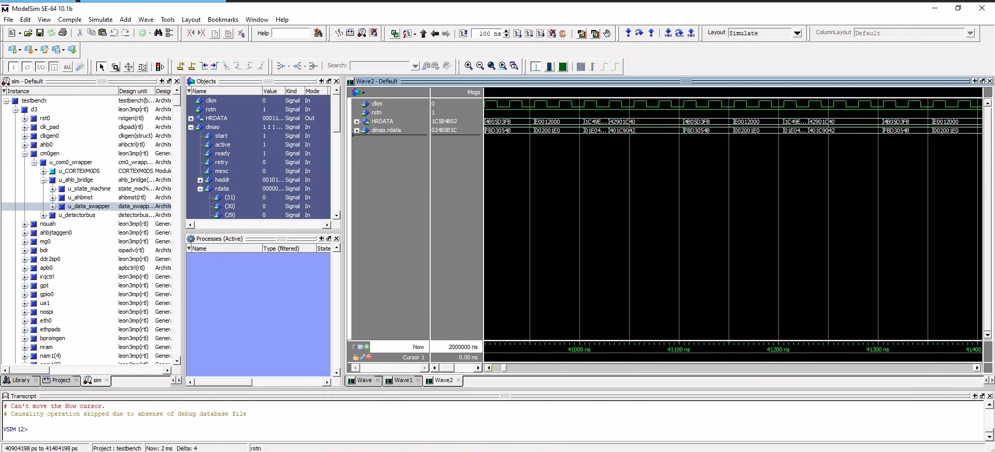
Design Checklist:
Check swapper and state machine VHDL code, check clock usage and correct combinational and sequential processes.
The figure 1.7 shows the Data_swapper model works in the right way.
Figure 1.7 Correct simulation of swapper.

Slide 9
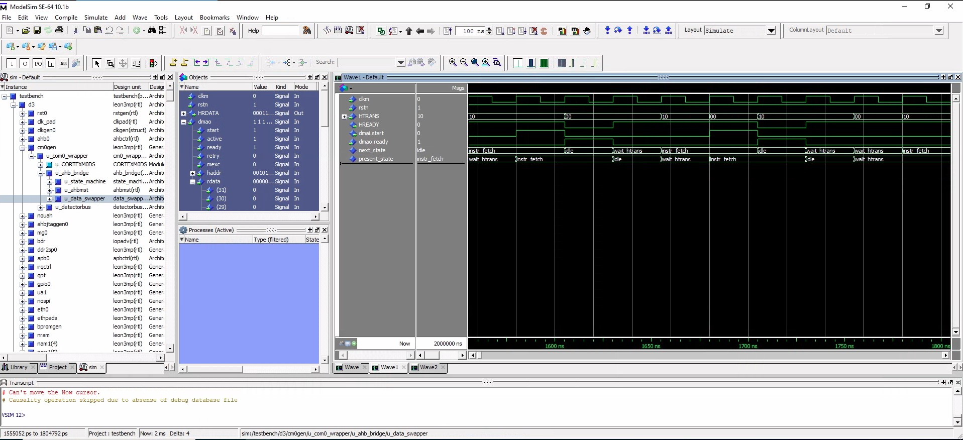
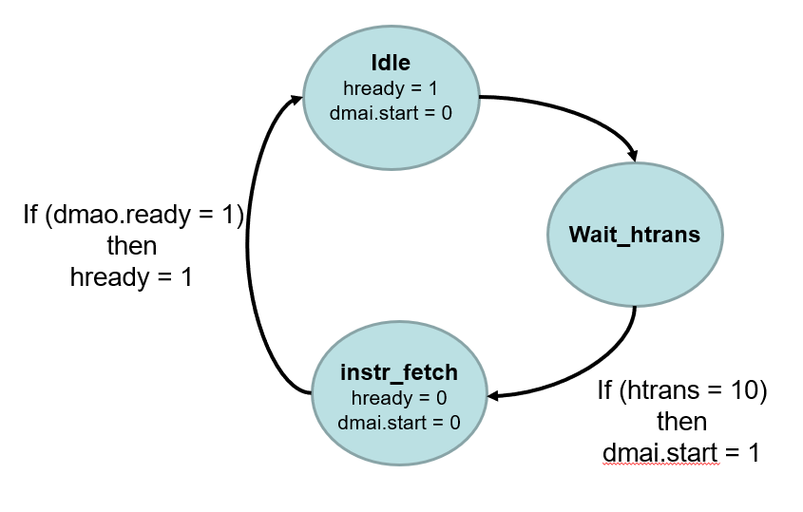
Design Checklist:
Check swapper and state machine VHDL code, check clock usage and correct combinational and sequential processes.
model
Figure 1.8 Correct simulation of state machine.
The figure 1.8 shows the state machine in action. The figure 1.2 shows the state machine diagram.
Idle is the initial state. HREADY is 1 and dmai.start is 0.
Then state will set to wait_htrans.
When the HTRANS is set to ‘10’, at the next rising edge of clkm the dmai.start is 1 and the state is set to instr_fetch. At next rising edge of clkm, the HREADY and dmai.start are set to 0.
When dmao.ready is ‘1’, at next rising edge of clkm, the HREADY is set to 1 and the state will be set to idle. At next rising edge of clkm, the Hat next rising edge of clkm READY is 1 and dmai.start is 0.
The state machine works in the right way.
Figure 1.2 The State machine diagram.

Slide 10
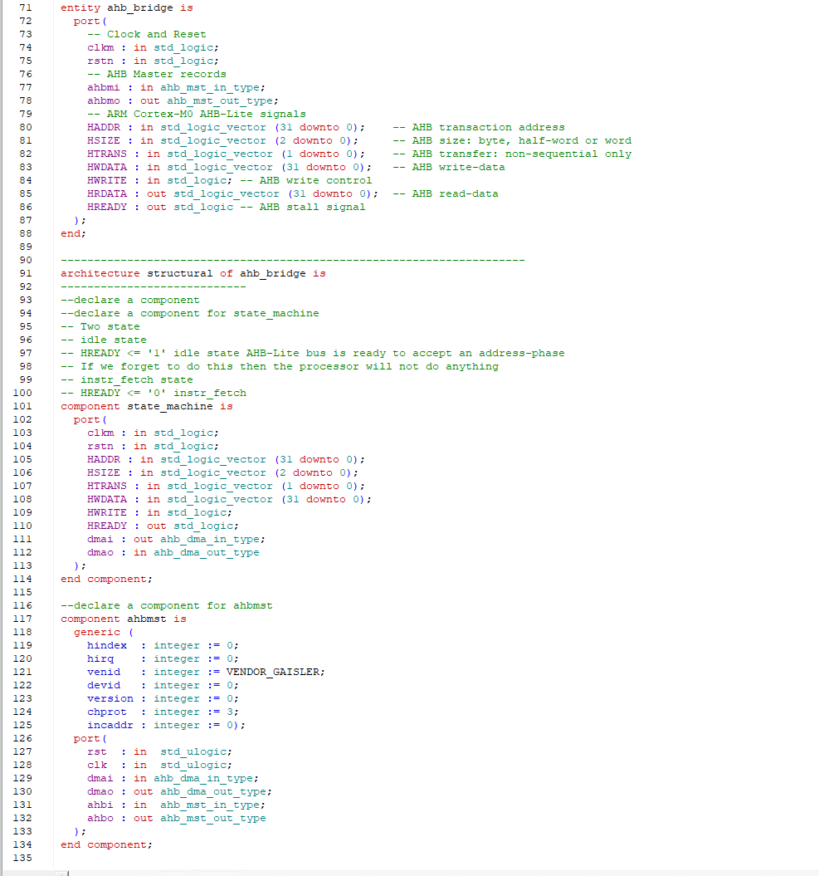
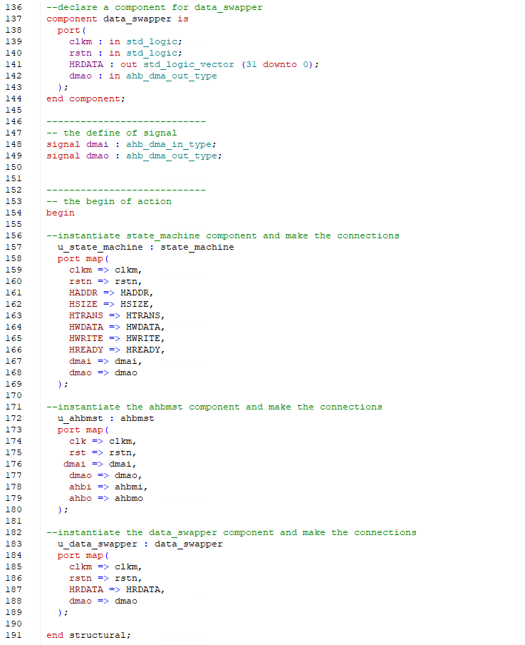
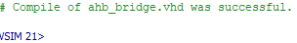
Design Checklist:
Verify VHDL code for hierarchy that should include AHB bridge, processor etc. Check components inside AHB bridge are correctly connected and look complete.
Figure 1.9 The main VHDL code.

Slide 11
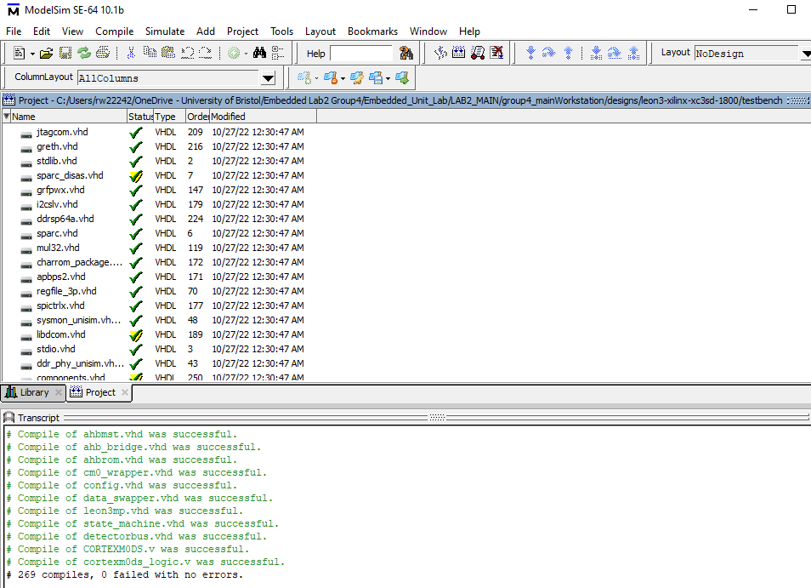
Design Checklist:
3. Show that the simulator compiles the VHDL code without errors.
Figure 1.10 Compile VHDL code correctly.

Slide 12
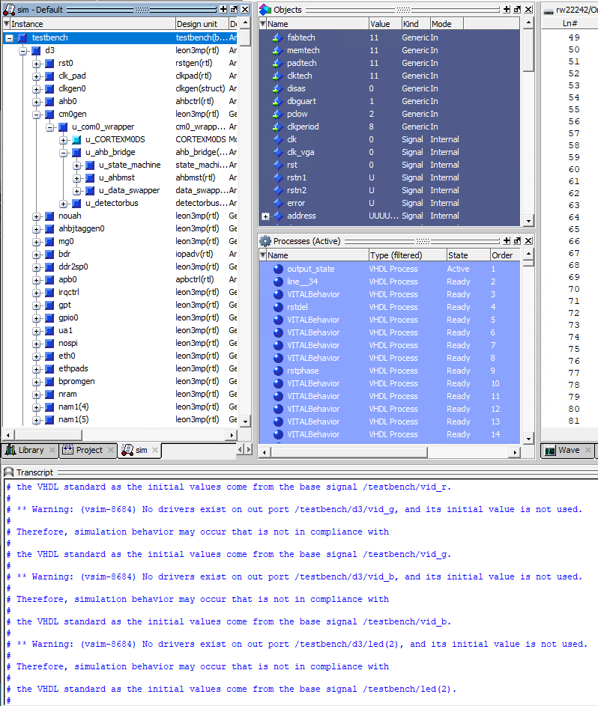
Design Checklist:
4. Show that the simulator loads the system VHDL without errors and testbench starting.
Figure 1.11 Correct simulation of testbench.

Slide 13
Design Checklist:
5. Show that the Cortex-M0 processor is running without entering undefined states.
The figure 1.12 shows the processor is running without entering undefined states.
Figure 1.12 Normal operation of the Cortex-M0 processor.

Slide 14
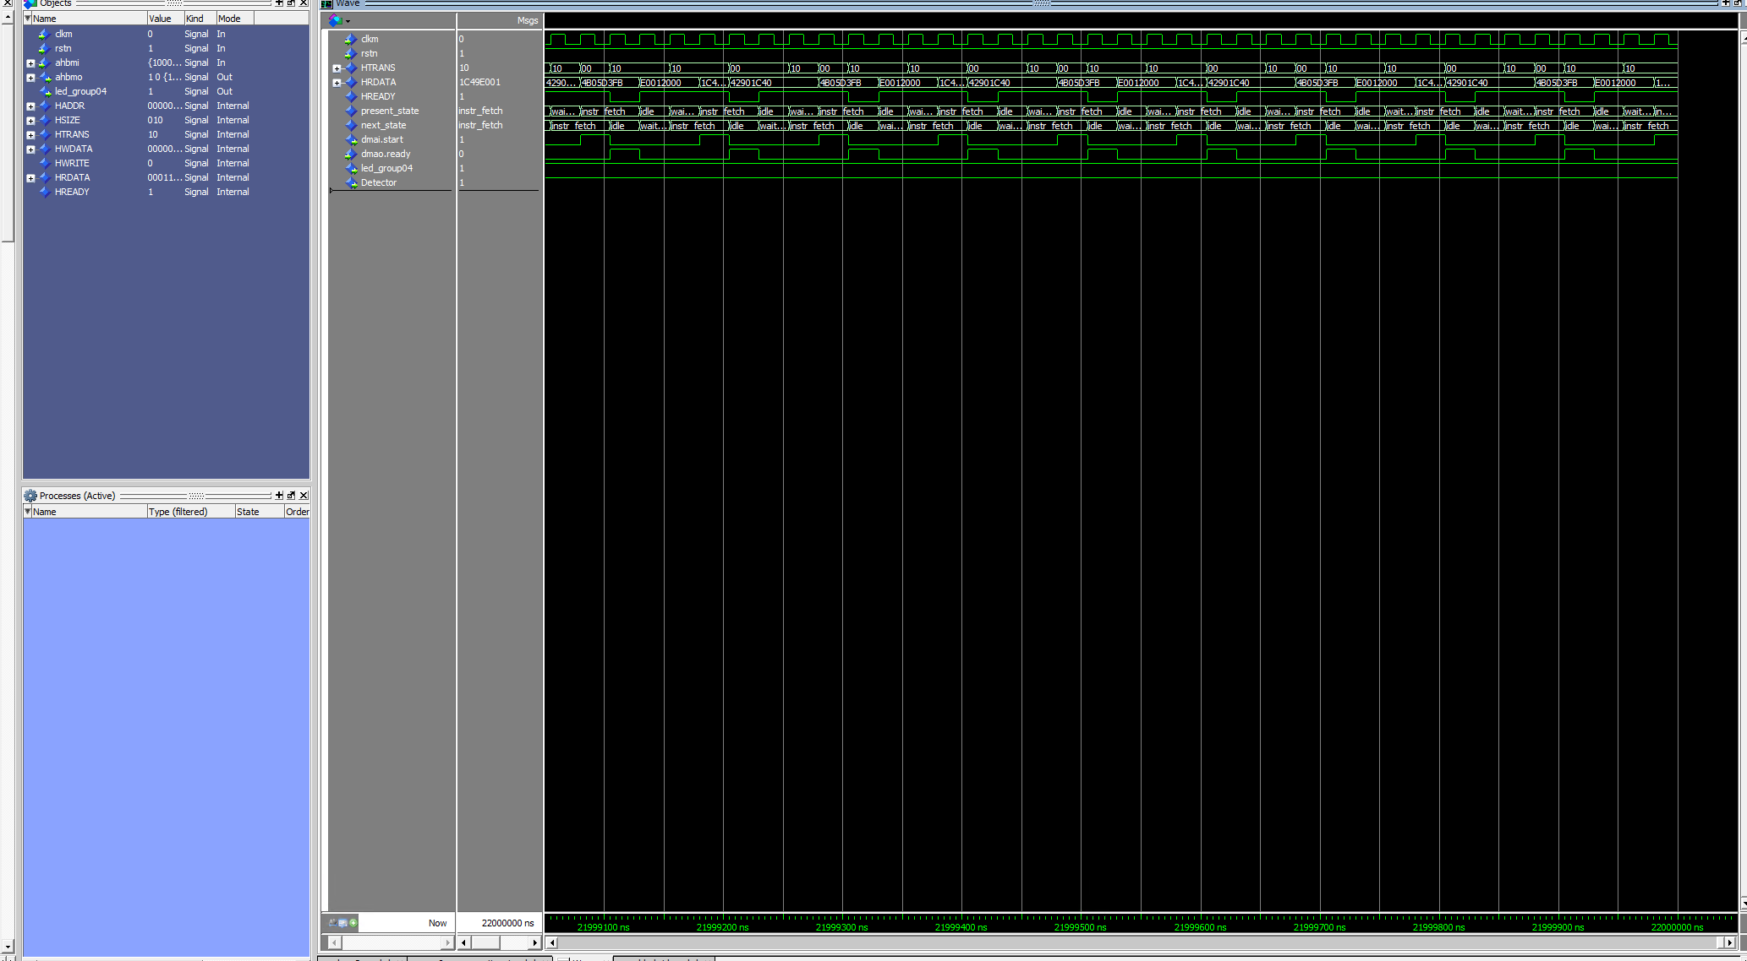
Design Checklist:
6. Show that the processor is running continuously without halting after some time.
We simulated 22000 us. The figure 1.13 shows the processor is running continuously without halting after some time.
Figure 1.13 The processor runs normally without halting.

Slide 15
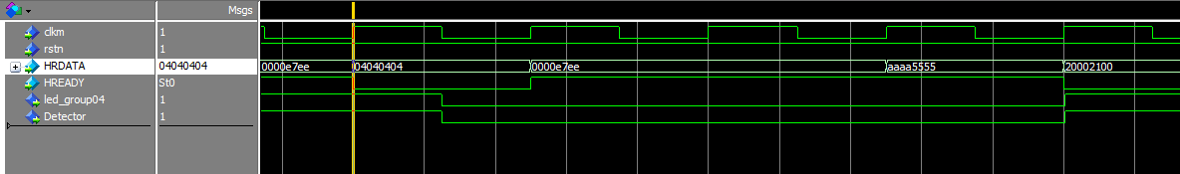
Design Checklist:
7. Show that the data patterns that trigger the led blinking appear in the HRDATA signal (your group number).
We are group 4. According to the figure 1.14, we found HRDATA signal has our group number to trigger the led_group4.
Figure 1.14 Blinking of LEDs.

Slide 16
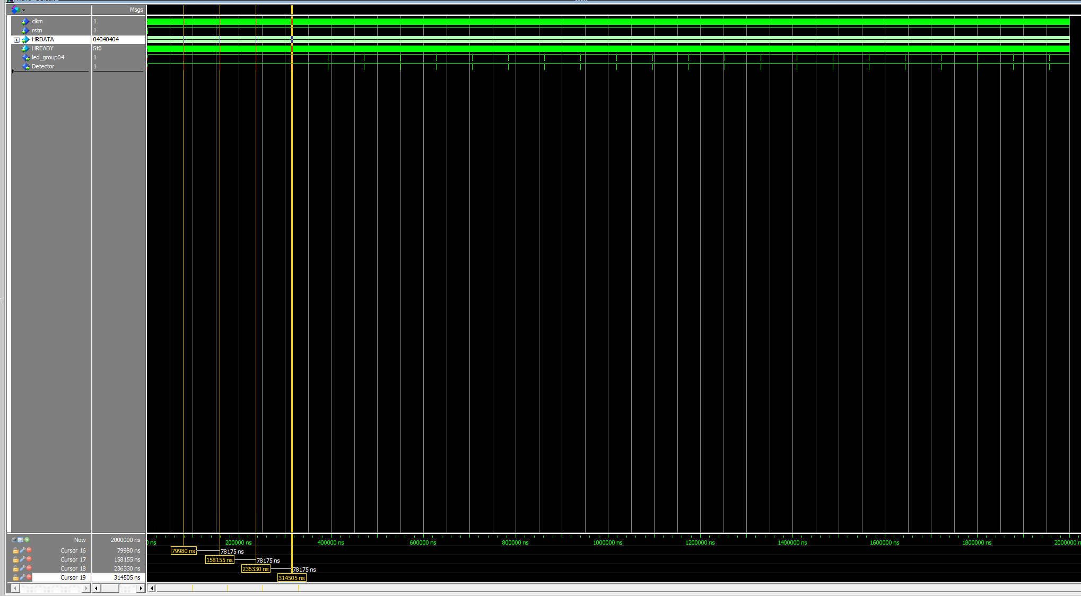
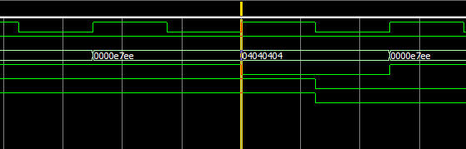
Design Checklist:
8. Show that the data patterns in HRDATA signal that trigger the led blinking are repeating periodically. (It should repeat once every ~62000 ns)
From figure 1.15, the led blinking trigger in HRDATA signal repeat once ever 78175ns.
Figure 1.15 Periodically repeat trigger LED flashing on HRDATA signal.

Slide 17
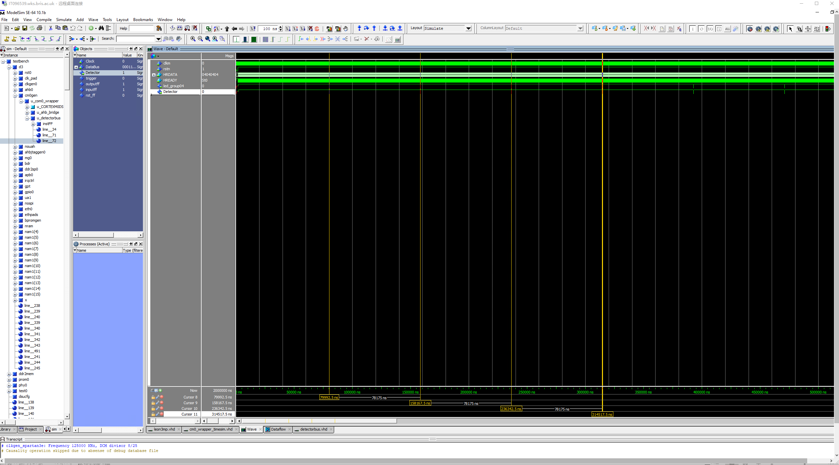
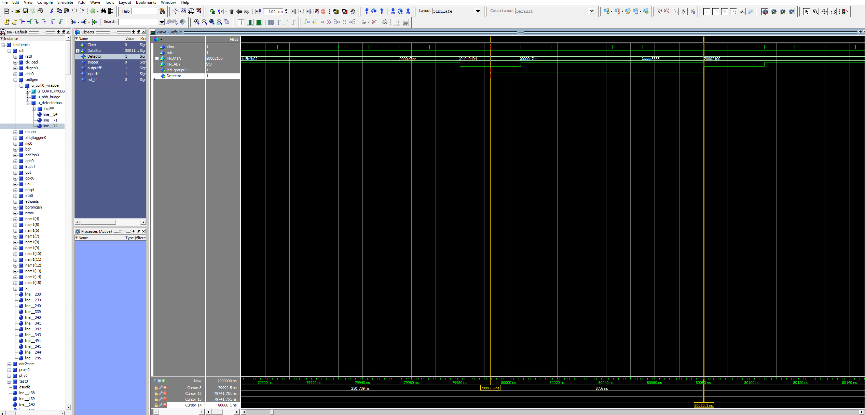
Design Checklist:
9. Show that the data patterns in HRDATA that trigger the led blinking repeating periodically are connected to a new user defined output in the testbench such as led.
Figure 1.16 New user defined output in testbench is connected.

Slide 18
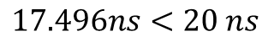
Design Checklist:
Check Vivado/ISE project for code completeness and correct Leon3 library set up. Does your design satisfy timing constraints?
$$17.496ns<20 ns$$
So our design satisfy timing constraints.

Slide 19
Design Checklist:
11. Check the implementation reports and FPGA Implementation Details Table.
Figure 1.17 The summary of design overview.

Slide 20
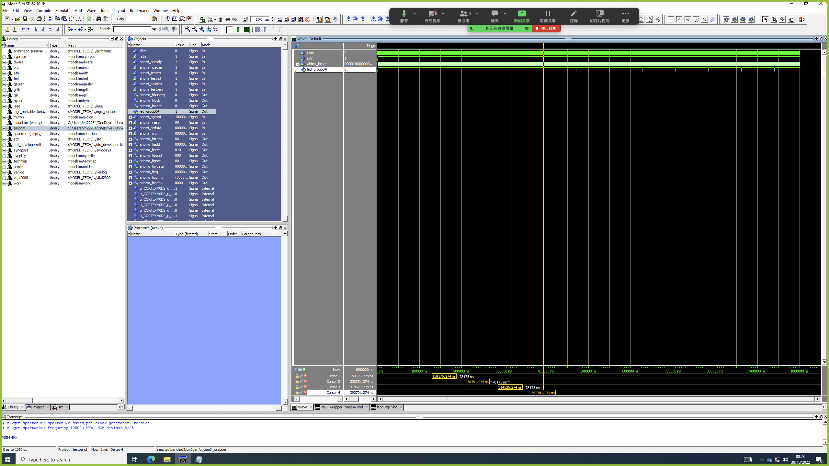
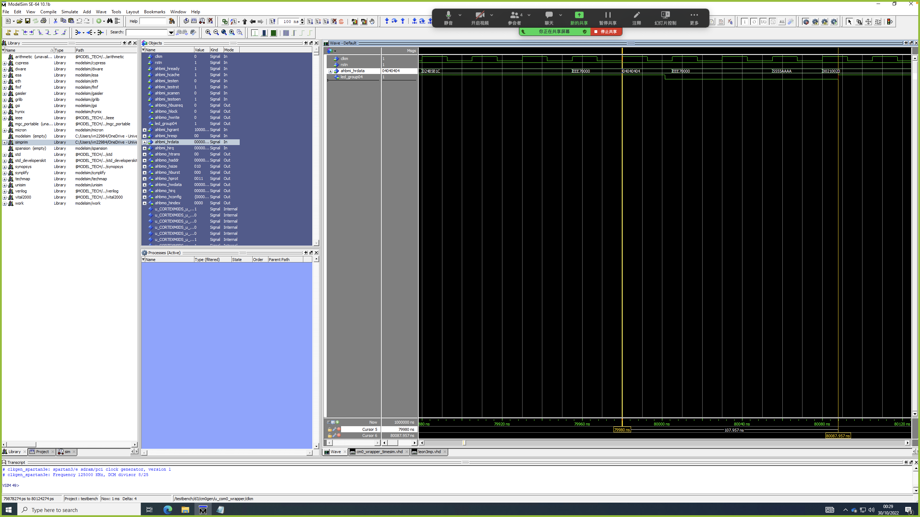
Design Checklist:
12. Show the simulation of the netlist with additional timing data (SDF files) working correctly with led blinking repetitions.
Figure 1.18 Netlist simulation about using SDF file.

Slide 21

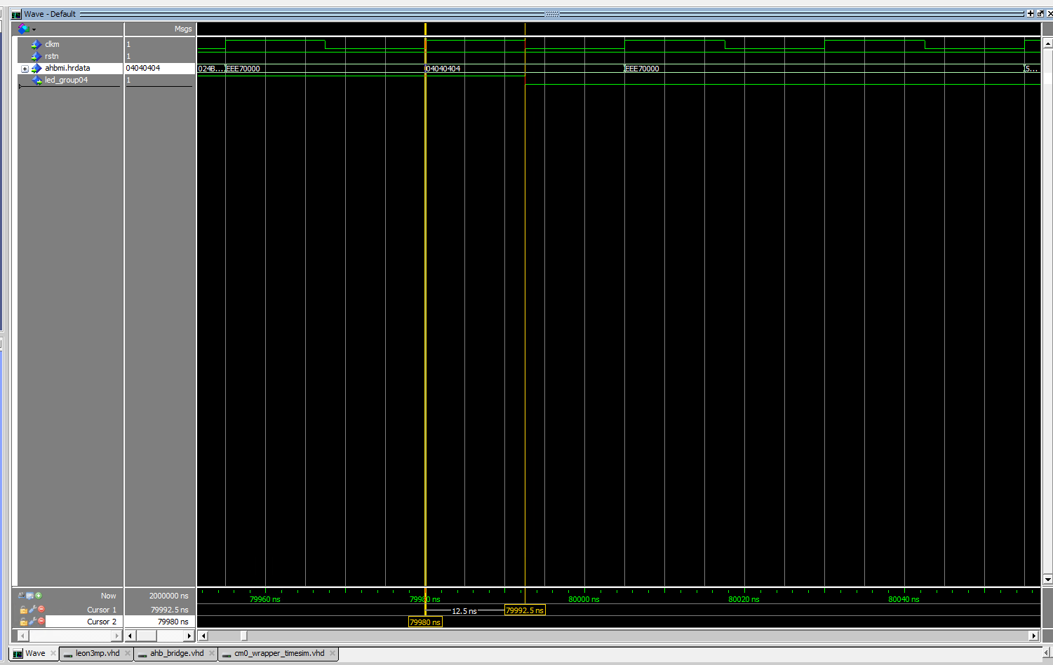
Design Checklist:
12.1 Compare the period(T) of led_group04 blinking simulation between the netlist with SDF files and the netlist without SDF files.
Figure 1.19 Compare after(left) and before(right) using SDF files.
21.547𝑛𝑠 −12.5𝑛𝑠=9.047𝑛𝑠
1 period = 25ns
After add SDF the led blinking time delay = 0.362 period

Slide 22
Thank You
Question?

